Slide 1
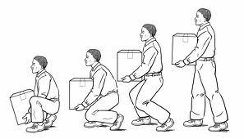
Body Mechanics & Range of Motion II Unit 5 Safety & Governmental Regulations
Health Science
Ms. Thieman
Fall 2013

Slide 2
Rationale Healthcare providers must know how to properly apply the principles of body mechanics to minimize personal and client injury.
Objectives
Upon completion of this lesson, the student will be able to:
• Explain how muscles, bones, and joints work together to provide movement
• Identify the principles of body mechanics
• Demonstrate proper body mechanics
• Demonstrate Range of Motion of the upper and lower extremities

Slide 3
Engage
The National Safety Council estimates that hospital workers are twice as likely as employees of other service industries to sustain work-related, Musculo-Skeletal injuries. Discuss which healthcare occupations and what activities are most at risk. Nurses are most at risk, while Physical Therapists are number 2. Activities include:
· Lifting
· Bending
· Twisting

Slide 4
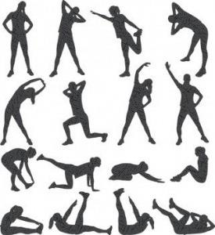
Body Movement
Accomplished by the musculoskeletal systems
The main framework of the body is covered with muscle
Allows movement
The type and extent of movement is determined by the load or resistance that is moved.
The arms and legs are like machines.
The action of muscles pulling on a bone are like a machine called a lever.
A lever is a rigid rod able to rotate around a point called a fulcrum.
In the body the rigid rod is the bone.
In the body the fulcrum is the joint.
Any force applied to the lever is called the effort.
Any force that resists the motion of the lever is called the load, or resistance.
In the body, contraction of the muscle is the effort.
In the body, the part of the body is the resistance or load.

Slide 5
Types of levers in the body
First-Class Levers
The placement of the fulcrum lies between the pull and the load, as in a set of scales.
The head being tipped backward on the atlas
the facial portion of the skull is the load.
the joint between the skull and the atlas is the fulcrum.
the muscles of the back produce the pull.
Second-Class Levers
The load lies between the fulcrum and the joint, where the pull is exerted.
Raising of the body on the toes
the point of contact between the toes and the ground is the fulcrum.
the load is located at the ankle.
the pull is exerted by the gastrocnemius (the muscle in the calf).
Third-Class levers
The pull is exerted between the fulcrum and the resistance or load to be moved
The flexing of the forearm at the elbow joint, as in lifting a hand weight
the load is the weight in the hand.
the pull is the biceps brachii muscle.
the fulcrum is the elbow.
This is the most common lever in the body***

Slide 6
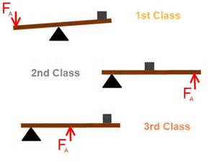
LEVERS
http://www.schooltube.com/video/fb2aac0c0c1d6fa17963/Levers

Slide 7
Proper Posture (the position of body parts in relation to each other) & Body Mechanics (using all body parts efficiently & in a careful way) are necessary in order to limit stress and strain on the musculoskeletal system.
Lifting, pushing, or pulling increases stress on the musculoskeletal system.
Principles
Use the larger and stronger muscles to perform work (shoulders, upper arms, hip and thighs).
Maintain the center of gravity in the body close to the center of the support base (feet provide a support base for humans).
Keep centered within the support base the combined center of gravity of the HealthCare worker and the object or person to be moved (hold objects to be moved close to you).
Have a support base that is the appropriate size & shape

Slide 8
Rules for proper body mechanics
Use stronger, larger muscles to perform tasks which require physical effort.
When moving a heavy object, try to push or pull it instead of lifting.
Maintain a wide base of support (feet approximately 12 inches apart).
Get help if the object feels too heavy to lift.
Lift in a smooth motion to prevent injury.
Maintain a good posture.
Avoid twisting the body; turn your whole body and face the area in which you are working.
Bend your knees, keep your back straight, spread the feet about one foot apart, and use your leg muscles while lifting.
Keep objects close to your body when lifting, moving, or carrying them.
Avoid unnecessary bending and reaching: raise the bed or over bed table to your waist level.

Slide 9
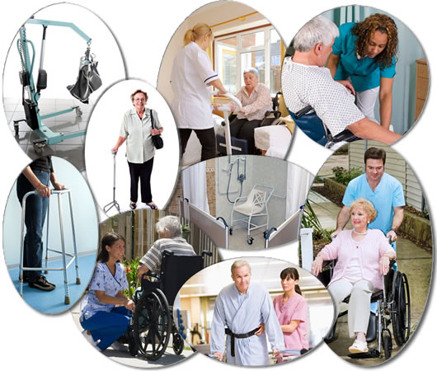
When to use Body Mechanics
At all times that you have to lift, move, or carry an item
In everyday daily activities: Ex. while cleaning, carrying books to school and to class, or getting in and out of a car.
In Healthcare settings: for example, while assisting a patient to a chair, picking up supplies, or positioning a patient in bed.

Slide 10
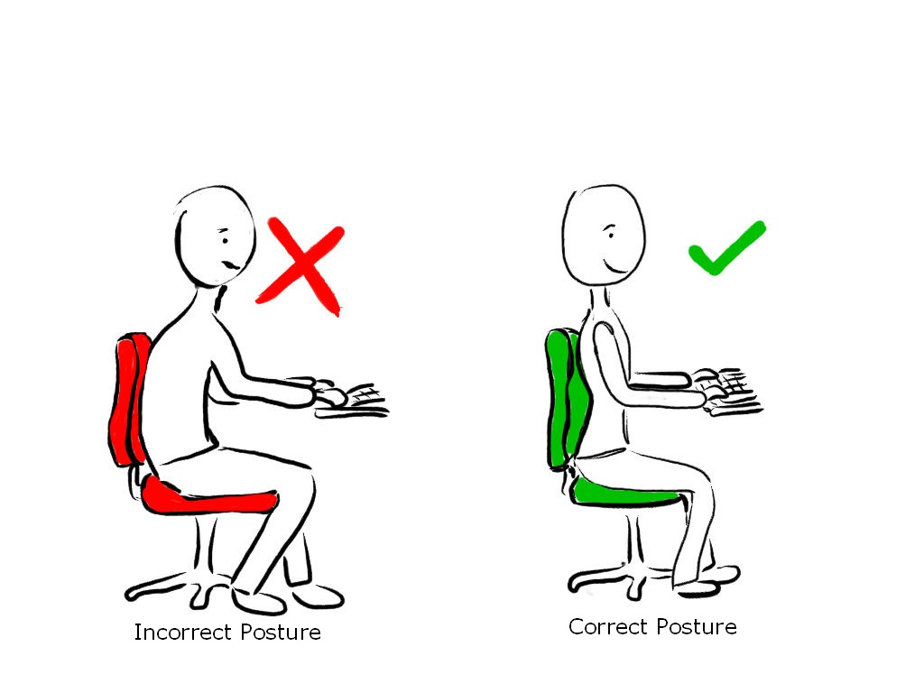
Ergonomics
Definition: the science of work.
The science of fitting the work to the user instead of forcing the user to fit the work.
OSHA has put emphasis on developing a policy of no lifting in Long Term Care Facilities and other high-risk areas.
The training program can be found at http://www.osha.gov/SLTC/etools/nursinghome/index.html

Slide 11
Range of Motion: the complete extent of movement which a joint is capable of
Used when doing routine activities such as bathing, eating, and dressing; uses muscles that keep many joints in effective range of motion
The purpose of Range of Motion
To prevent problems caused by a lack of movement
To prevent problems caused by inactivity
Contractures: the tightening and shortening of a muscle: for example, foot drop
Muscles may atrophy (shrink) when they are not used.
Joints become stiff
Blood clots and decubitus ulcers may develop.
Active Range of Motion – those movements performed by the patient without help
Passive Range of Motion – a movement cannot be performed by the patient and the health care worker moves each joint through its range of motion.
Active Assistive Range of Motion – the patient does the exercises with some assistance from another person

Slide 12
General rules for Range of Motion
Use good body mechanics; raise the bed to your waist level if the patient is in bed.
Expose only the body part being exercised.
Explain to the patient what you are going to do, and teach the patient how to do it.
Support the extremity being exercised (place hands under the extremity, supporting the joint above and the joint below the one you are exercising).
Move each joint until there is resistance but not pain.
Move each joint slowly, smoothly, and gently.
Return the joint to a neutral position after the movement.
Keep friction to a minimum.
Repeat each exercise 3-5 times.

Slide 13
Joint Movement
Abduction – moving a body part away from the midline
Adduction – moving a body part toward the midline
Flexion – bending a body part
Extension – straightening a body part
Hyperextension – excessive straightening of a body part
Rotation – moving in a circle at a joint
Pronation – turning a body part downward
Supination – turning a body part upward
Inversion – turning a body part inward
Eversion – turning a body part outward
Dorsiflexion – bending backward
Plantar flexion – bending forward
Radial deviation – moving toward the thumb side
Ulnar deviation – moving toward the little finger side

Slide 14
Activity
I. Complete the Body Mechanics Activity.
II. Complete the Range of Motion Activity.
III. Demonstrate principles of proper body mechanics. See the Body Mechanics Checklist. If you do not have a lab with beds, have students transfer a patient (another student) from one chair to another.
IV. Demonstrate Range of Motion. See the Range of Motion Checklist.
V. Complete the Body Movement Worksheet.

