Slide 1
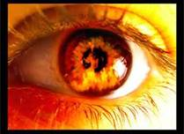
Fire Prevention & Safety Practices Unit 5 Safety & Governmental Regulations
Health Science
Ms. Thieman
Fall 2013

Slide 2
Rationale Fires may occur at any time, as a result of overloaded wiring, smoking, improper chemical storage and various emergencies. Health care providers must recognize and respond to fire risk situations and use caution in protecting clients, families, other workers, as well as safeguarding hospital property and oneself.
Objectives
Upon completion of this lesson, the student will be able to:
Recognize fire safety hazards
Recognize the meaning of the acronym RACE
Assess fire prevention and safety practices according to facility protocol
Propose an emergency action plan

Slide 3
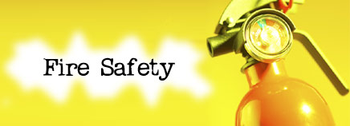
Engage Do you have a fire escape plan for your home? Do all your family members know where the fire extinguishers are? Do you have smoke alarms installed, and are they functioning properly? Does the fire department know where water can be obtained near your home?

Slide 4
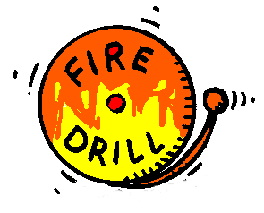
HAVE TWO WAYS OUT PSA
http://www.usfa.fema.gov/campaigns/smokealarms/escapeplans/index.shtm
FIRE ESCAPE PLANNING
http://www.youtube.com/watch?v=nLq9kT8E-Ro#t=15

Slide 5
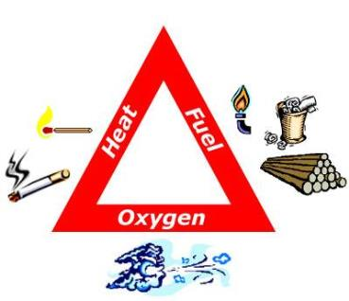
Fire safety in health care facilities: hospitals, nursing homes, and clinics present a specialized response.
Many patients have special needs that make them especially vulnerable in a fire emergency, thus increasing the risk of fire-casualties.
Healthcare staff must therefore make every effort to prevent fires from starting and must be prepared to respond if a fire breaks outs.

Slide 6
Fire Hazards
The most common cause of fire in health care facilities is from smoking materials.
If smoking is permitted in your facility, all staff should know the smoking rules and be ready to enforce them.
If smoking is allowed, large, deep, non-tip ashtrays should be used.
Ashtrays should be emptied often into metal containers.
Smoking should never be allowed where oxygen is in use or is stored.

Slide 7
Another major fire hazard is faulty or improperly used equipment. All equipment should be checked on a routine schedule. Be especially attentive to the following equipment hazards:
Cracked or split cords or plugs on electrical equipment.
Overloaded extension cords or cords placed where they may be stepped on.
Dirty or greasy kitchen equipment.
Full laundry lint screens.
Any indicated malfunction of an oxygen machine or gas compressor.
Improperly lubricated fan motors and worn drive belts.
Lights in close proximity to paper or fabric.
In use but unattended cooking equipment.
Improperly maintained or malfunctioning heating, ventilating, and cooling equipment.
Office equipment left running continuously.

Slide 8
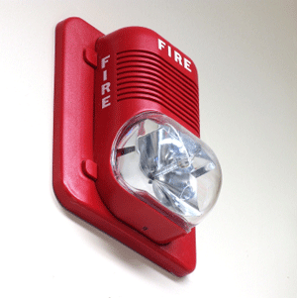
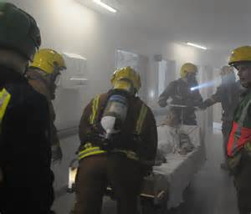
Fire Response - Know the following:
Facility’s emergency plan.
Location of fire alarms and how to operate them.
How to shut off oxygen machines and other compressed gas systems.
Location of fire extinguishers and how to use them.
How to move patients safely and quickly if necessary.

Slide 9
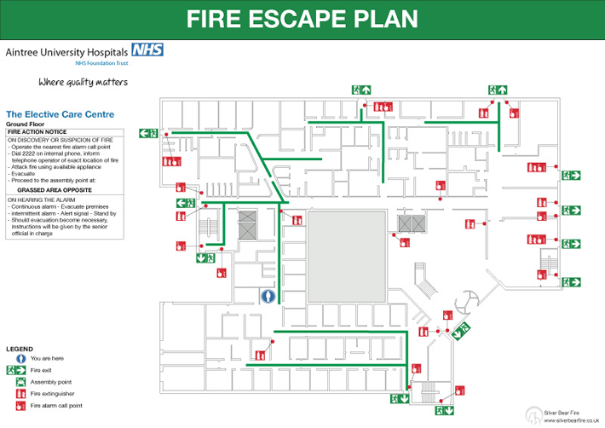

Slide 10
Remember the RACE Against Fire
RESCUE any individual directly threatened by fire. Patient safety is the primary consideration, so move patients who are in immediate danger away from smoke and flames. Place the patient in a nearby room, behind a closed door.
ACTIVATE the alarm if you discover a fire or respond immediately to the alarm if you hear it sound.
CONFINE the fire by closing doors to slow the spread of smoke and flame. Close the doors of patients’ rooms. In general, residents are safer in a closed room than in a smoke- filled hallway.
EXTINGUISH the fire only if the fire is small, and if you know how to operate a fire extinguisher. Be sure the area has been cleared and the fire department called.

Slide 11
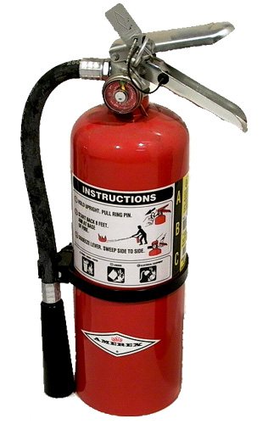
Types of Fire Extinguishers
Class ABC fire extinguishers are used for any type fire
Class B fire extinguishers are used on grease fires
Class C fire extinguishers are used on electrical fires
HOW TO USE A FIRE EXTINGUISHER
http://www.youtube.com/watch?v=BLjoWjCrDqg

Slide 12
Activity Develop an emergency action plan for your home & discuss with your family. Include 2 ways out of every room, a meeting place, and a “key” for smoke alarms/fire extinguishers. Assessment Construct a fire safety brochure.
ANY QUESTIONS???

