Slide 1
Problem Solving Unit 1 Leadership
Health Science
Ms. Thieman
2013-2014

Slide 2
Rationale
Healthcare teams must rely on an evaluation of the factors involved in a decision, and the risks and consequences of their actions.
Objectives
Upon completion of this lesson, the student will be able to: 􏰀 Adapt and utilize problem-solving skills to resolve conflicts.

Slide 3
Engage
The team from the CDC in charge of investigating an outbreak of food-borne illnesses at a HOSA conference has requested your assistance. They would like you to develop a questionnaire for those who are ill, in order to determine the specific types of illnesses they have, how they got them, etc.
Where do you start? What do you do next? What help do you need?

Slide 4
Problem solving involves a four step process
Identify the problem.
List all alternatives.
Name the consequences of the alternatives.
Evaluate and choose the best course of action.

Slide 5
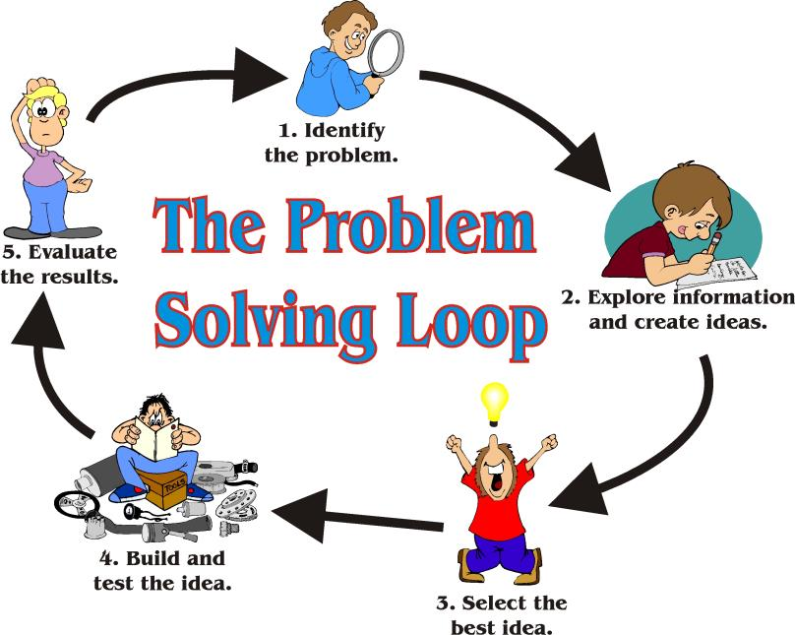

Slide 6
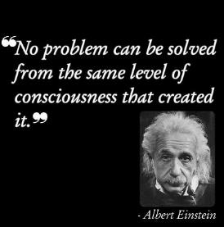
Step 1
The true problem must be clearly understood and identified.
Gather all the facts [assemble all the information].
Ask specific questions.
Stay as objective as possible.

Slide 7
Step 2
Once the problem is identified, brainstorm possible solutions. Rules for brainstorming:
Limit the discussion to one issue or problem.
Set a time limit to encourage creativity and quick thinking.
No evaluating of any kind is allowed. The goal is quantity, not quality.
Encourage members to build on what
has been said and modify the ideas.
Have a recorder write down every idea.

Slide 8
Step 3
Identify all the possible consequences that might result from the possible alternatives.
These may be good or bad outcomes.
Depending on the problem, the group may want to divide and research possible solutions before identifying consequences.

Slide 9
Step 4
Label each consequence as a positive (good) or negative (bad) factor.
Rank ideas according to those that have the greatest potential for success.
Finally, chose a solution to the problem.

Slide 10
Activity
Evaluate a healthcare issue, working in small groups (4 or 5).
Formulate an effective solution to the healthcare problem and validate it using resource materials.
Present potential solutions to be critiqued by your peers.

Slide 11
Any questions???

