Slide 1
Healthy Relationships Unit 2 Communication
Health Science
Ms. Thieman
Fall 2013

Slide 2
Rationale Students should be aware that creating, as well as maintaining, healthy relationships will help them reach their career goals from their first job through their last.
Objectives
Upon completion of this lesson, the student will be able to:
· understand the workings of a health relationship;
· identify the components of effective communications;
· outline the skills necessary for developing healthy, stable relationships with co-workers, employees, and employers.

Slide 3
Engage Name one quality that you consider to be a “must” in a healthy relationship. Youth Advisory Counsel http://www.youtube.com/watch?v=tyJJ9aSJICM#t=20

Slide 4
No relationship is ever perfect
Many relationships end because people don’t communicate well and they mismanage conflicts in their relationships
People of all ages can learn how to build and maintain a healthy relationship
The quality of relationships in the work place has a significant impact on the quality and quantity of work that gets done
There are a set of skills that people can learn and practice to maintain a healthy relationship
Be comfortable with who you are and have confidence in your abilities
Respect each other
Accept others for who they are and not who they aren’t
Communication should be open, clear and honest
Recognize when there is a conflict and manage it without violence
Do things to show caring and appreciation for one another
Trust each other
Surround yourself with people who support you and your ideas

Slide 5
Healthy Relationships continued…
Healthy relationships increase your energy for other things in your life; the relationship can inspire you rather than drain you.
It is never a good idea to completely wrap yourself up in your job to the exclusion of your family and friends
If something tells you that something is not right in a workplace relationship, listen! Talk with someone you trust, other than the person you have a problem with; then resolve the issue with him/her without verbal, physical, or emotional abuse
Men and women handle conflict with different styles
Women may be more likely to raise concerns and problems and want to talk about what they are feeling
Men may be more likely to avoid conflict and downplay the strong emotions that they feel inside

Slide 6
Communication
Professional relationships may end because people don’t know how to communicate effectively and don’t know how to manage conflicts
Communication and conflict resolution are skills that can be learned and practiced
Being able to communicate and work out conflicts respectfully will help you at home, with friends, at school, and on the job
All relationships have some conflict; conflict in and of itself is not bad – it’s how we react to the conflict that can be negative or destructive
Too much conflict is bad
It’s OK and normal to have conflict as long as you have some skills and strategies to work through the conflict

Slide 7
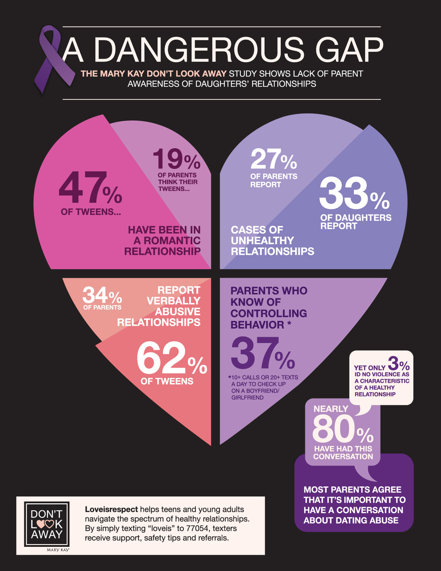

Slide 8
Managing conflict
Be respectful and when you have a problem with something the person is doing, voice a complaint rather than a criticism
Complaint: I get uncomfortable when your music is too loud and I can’t concentrate.
Criticism: What is wrong with you? Don’t you know that playing loud music is immature?
Avoid name calling, blaming, put-downs, using the words ‘always’ and ‘never’ & so on
Avoid being defensive or “flipping the script”(sidestepping or changing the topic) if you employee or employer voices a complaint
Use good listening skills; make sure that you understand what each other is saying, especially when discussing a difficult issue
Build a foundation of positive feelings with one another; tell each other what you appreciate; and look out for each other -- strive to have more positive than negative interaction
When you catch yourself being defensive, overly critical, or blaming, stop!
Do something to change the tone of an argument or to reduce the intensity
Soften what you’re saying to make it sound less hostile
De-brief the conflict
Sit down and talk after an argument
Take responsibility for your role in the problem
Discuss what both of you can do to make it better in the future

Slide 9
Anger
It’s a normal and natural feeling
It’s what you do with your anger that makes a difference
We all have different ways of expressing our anger
Anger can:
Wound you and your relationship or get you fired
Be so blinding that it keeps you from seeing another point of view or your own role in the conflict
Lead you to say or do things you later regret
Invite violence

Slide 10
Anger is getting out of hand when:
Either person seems overheated or out of control You’re arguing in a way that is going nowhere
You’re getting louder and angrier by the minute
Either of you is saying extremely negative things that you can’t take back
You appear at risk of coming to physical arguments

Slide 11
Ground rules for dealing with anger:
When conflict is getting out of control, terminate it
Take a time out and remove yourself momentarily from the conflict or conversation and cool off
Never block someone from leaving or follow after him or her
Once you’re away from the situation, do things to soothe yourself and don’t engage in negative self talk
Wait to reconvene until you’re both feeling normal again to have a discussion
Don’t bring up the conflict again
Use communication skills to be sure you really understand each other

Slide 12
Get help if:
You have reason to believe that you’re in over your head and can’t handle things alone
You’re irritable all the time & can’t get a handle on it
The fighting is intense and frequent
There’s physical violence of any type
You see a cycle of angry outbursts followed by feelings of remorse
Teen Dating Violence Awareness http://www.youtube.com/watch?v=XKd7icwmuFc

Slide 13
Activity
Complete What Makes a Relationship Healthy activity.
Complete the Scenarios. http://teen.fightforzero.org/info-for-teens/
Accommodations for Learning Differences
For reinforcement, students will evaluate the pros and cons of having a healthy relationship at their place of employment. (If they do not have a job, have them evaluate a nurse working the hospital). Students can also role play using the conflict resolution and mediation script from the Conflict Resolution and Mediation lesson.
For enrichment, students will interview two people who are managers or someone who has authority over their employees, as well as interview employees, to find out what they view to be the most important factor in maintaining a healthy working relationship.

