Slide 1
Nonverbal Communication Unit 2 Communication
Health Science
Ms. Thieman
2013-2014

Slide 2
Rationale Research indicates that more time is spent communicating nonverbally than verbally and nonverbal messages carry more meaning than verbal messages. It is important to be aware of how nonverbal messages are perceived by others.
Objectives
Upon completion of this lesson, the student will be able to: • Examine nonverbal forms of communication, functions, characteristics, and interpretation • Improve nonverbal communication skills • Adapt appropriate communications to the needs of the individual • Explain the importance of nonverbal behavior in the communication process • Act out a dialogue using gesture & expression only

Slide 3
Engage: Charades
Divide the class into 2 or 4 groups; and each group needs 2 pieces of paper.
Brainstorm 2 song titles or movies and write them down on their slips of paper. *no more than 5 minutes!
Put your slips of paper in your cup.
The first team picks a person from their group to go first. This person draws a slip from another group and has 3 minutes to act out the song or movie title.
Reminder: students cannot speak or write any clues down. If the team members guess the correct title, write the time down. If the team members do not guess the correct title within the 3 minutes then write down 3 minutes for a score.
Continue with each group picking a slip from another group and acting it out. The group with the shortest time wins.
Discuss what types of communication they saw. Include facial expressions, eyes, and hands.

Slide 4
Nonverbal Communication
Sending & receiving wordless messages
A. Expresses more of the meaning of a message than verbal communication B. Understanding the message
7% by spoken word
38% by the tone of the voice
55% by body language

Slide 5
Types of Nonverbal Communication
Gestures
Express variety of feelings
Contempt
Hostility
Approval
affection
Can be used in addition to words
Differ by culture
Body Language & Posture
Facial Expressions
Eye Contact
Object communication (clothing & hairstyles)
Touch

Slide 6
Body Language & Posture
unconscious barrier between you & the receiver - crossing arms
disbelief – scratching chin
good health/positive attitude – standing up straight
fatigue -slumped posture
angry - clenched fist
anxiety - clearing the throat
assertiveness - pointing finger
boredom - leaning on one's elbow with the chin in the hand
boredom - wiggling a foot
concealing something - no eye contact
defiant - hands on hips
dominance - sit backwards on a chair
doubtful - touching ear
everything under control - thumbs in belt or pants
expectation - rubbing palms
feeling superior - hands behind back
guilt - lowering the eyes
honesty - open palms occasionally touching the chest
impatience - tapping or drumming fingers
insecurity - biting fingernails
interest in someone or something - tilted head
lack of confidence - failing to look someone in the eyes
lying - touches face
making a decision - stroking chin
needing reassurance - hand to throat
nervous - fiddling with items
readiness - standing with hands on hips
rejecting what is being said - rubbing nose
unconcerned - leg swung over chair
unwilling - arms crossed tightly across chest

Slide 7
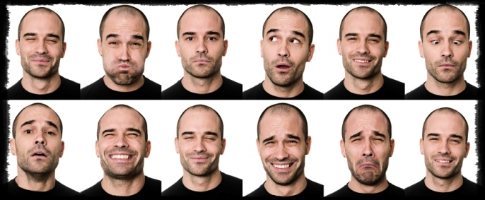
Facial Expressions
Most expressive part of the body
7 universally accepted emotions shown
Fear
Anger
Surprise
Contempt
Disgust
Happiness
Sadness

Slide 8
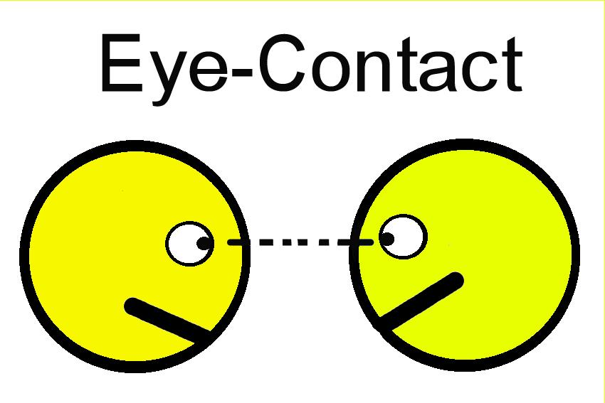
Eye Contact
Often initiates communication
Good contact means respect, a willingness to listen, and to keep communication open
Looking away means anxiety, defenselessness, or avoidance of communication
Cultural Differences
view eye contact as an invasion of privacy
eye contact considered disrespectful

Slide 9
Object communication such as clothing and hairstyles
Healthy people with good self-esteem pay attention to the way they dress and grooming
People feeling ill show much less interest in appearance/dress
Health Care Workers
Uniforms clean, neat and well fitting
If uniforms not required, clothing should be clean, neat and appropriate to the area (e.g. jeans may be allowed in recreation therapy but not in a nursing area or an office)

Slide 10
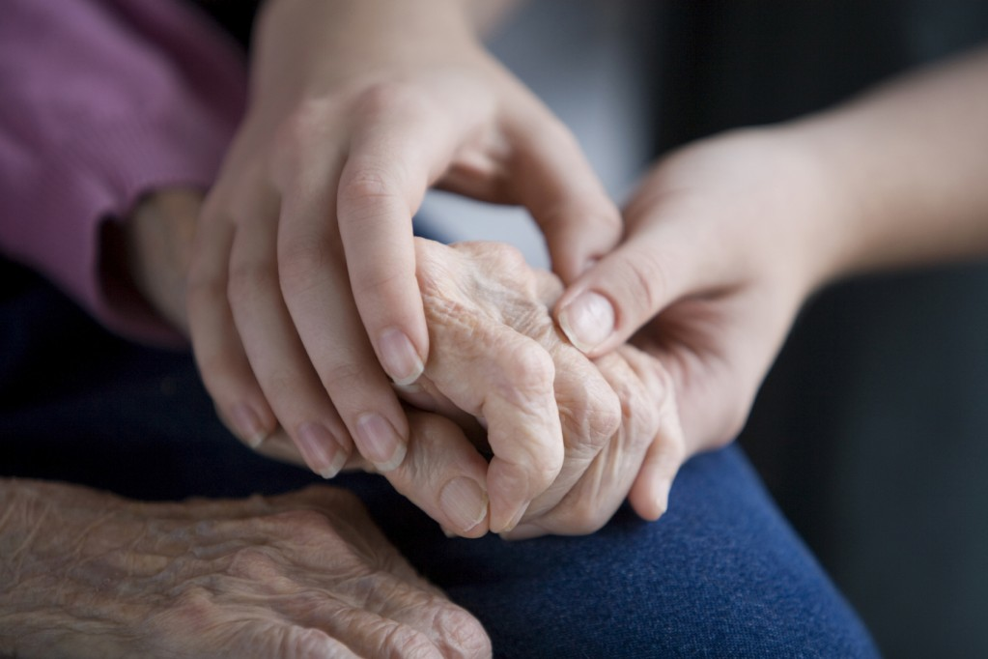
Touch
Multiple meanings
Positive message: provide affirmation, provide reassurance, share warmth, approval and emotional support
Negative message: anger, frustration, punishment, invasion of personal space
Health care worker needs to weigh the benefits against the negatives when using touch

Slide 11
Any questions???
Activity I. Complete the Nonverbal Communication Activity.
II. Complete the Survey of Nonverbal Impressions.
Accommodations for Learning Differences
For reinforcement, students will role play emotions that express nonverbal communication (fear, anger, pain).

