Slide 1
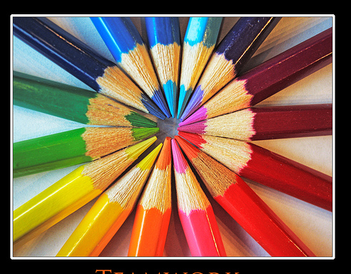
Teamwork Unit 1 Leadership
Health Science
Ms. Thieman
2013-2014

Slide 2
Rationale
Healthcare workers function as team members, and work with people from diverse backgrounds. Quality healthcare depends on the ability to work well with others.
Objectives
Upon completion of this lesson, the student will be able to: 􏰀 Investigate the aspects of consensus and try to utilize it as a decision-making tool.

Slide 3
Engage
Have students brainstorm the following questions:
When do people have to work as a team?
What happens when people don’t work as a team?
Who suffers when people don’t work as a team?

Slide 4
MONTAGE
http://youtu.be/OERgoDcJ3_o

Slide 5
Group Dynamics
Individuals assume various roles when in a group
Some are elected to leadership roles such as:
President
Vice President
Secretary
Treasurer
More informal roles are assumed by all group members & may include the following…

Slide 6
Informal Roles
Information Seeker
Asks questions
Looks for new ideas
May sound doubtful
Is willing to research topics and issues
Is open to new ideas
Tension Reliever
Encourages risk taking
Uses humor to relieve the tension
Maintains a steady, calming attitude
Looks for consensus during arguments
Clarifier
Connects disparate ideas into new wholes
Creates visual interpretations of the data
Orders and organizes discussion items
Is an analytical and critical thinker

Slide 7
…more Informal Roles
Initiator
Organizes the discussion into a practical plan of action
Is good at assigning tasks and delegating actions
Is very goal- and performance-oriented
Is always enthusiastic and positive about the future
Gatekeeper
Knows the rules in depth
Watches the clock
Keeps everyone in line
Challenges new ideas
Needs to be convinced
Harmonizer
Serves as the group cheerleader
Minimizes conflicts and differences of opinion
Looks out for the feelings of all group members
Is enthusiastic and caring

Slide 8
…final Informal Roles
Follower
Wants to do something concrete
Waits for the “experts” to tell him or her what to do
Always supports the initiators in the group
Information Giver
Comes to all meetings with all the notes and hand-outs from previous meetings
Is always careful to state all the pertinent facts
Is very detailed-oriented
Never forgets information but may forget how you felt about something

Slide 9
Roles are determined by personalities, qualities, and values that we have as individuals.
Some of the qualities include:
Trust
Sensitivity
Belief in Consensus
Pride in the Organization
Value of Individual Differences
Promptness
Organization
Enthusiasm
Critical Thinking

Slide 10
REMEMBER
http://youtu.be/S02D9QzDe4s

Slide 11
Consensus
Parliamentary Procedure is the rule by majority.
Majority rule is the most effective if a consensus is reached.
The definition of consensus is a “collective opinion or concord – general agreement or accord.”
There are some misunderstandings about consensus.

Slide 12
Misunderstandings…
Consensus does not mean that everyone agrees with what is being done – it is simply a general agreement to carry on with something.
All team decisions should be made by consensus.
The final consensus decision reflects the first choice of each team member.
That consensus is fast and easy.
Consensus is compromise.
***Keep in mind these are MISUNDERSTANDINGS, and they are NOT TRUE!!!

Slide 13
There are some general beliefs about consensus.
Consensus is a mindset as well as a process.
Consensus that is authentic requires that team members be more concerned about community and less concerned about power.
Consensus requires that the team be more focused on team productivity than on individual credit.
Consensus demands mature behavior on the part of everyone.
The recognized leader holds himself or herself and others accountable for open, honest participation.
The team must be open to continuous learning in order to use consensus effectively.

Slide 14
In order for consensus to be a viable option, ground rules must be established and followed.
Disagreement is acceptable as long as the person explains why they disagree.
Expressed differences of opinion help to expose all available alternatives.
Rigid argument for one position should be avoided – all members’ reactions should be heard and considered.
One should never change his or her mind to avoid conflict; support should only be given to options that are truly accepted.
Evaluation should be suspended until all points of view are presented and understood.
Have a backup plan in the event a consensus cannot be reached.

Slide 15
Examples of when a Consensus cannot be reached may include the following:
No decision – the idea is dropped and status quo continues
Third party decides
Leader decides
Designated committee decides
Luck decides
Split Decision
Majority rules – or an agreed upon percentage

Slide 16
Consensus Process
The issue is clarified.
Discussion of the issue
Re-clarify any parts of the issue.
Each individual gives their stance.
The minority expresses their view.
The team problem-solves the minority’s view.
Again, each individual gives their stance.

Slide 17
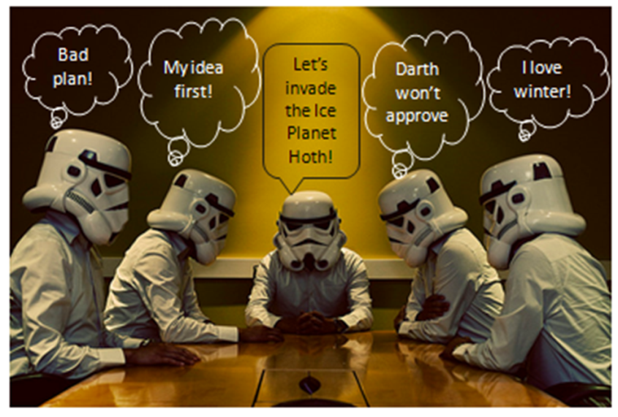

Slide 18
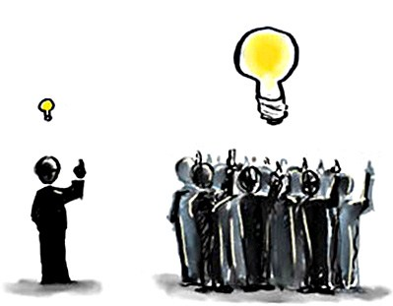
Levels of agreement in a group
100% consensus
Sufficient consensus
Democratic (majority rules)
Autocratic, with input from the group
Totally autocratic

Slide 19
Negative behaviors and distracters in group dynamics
The latecomer
Arrives late
Makes a big commotion
Wants to be caught up on everything that has happened
Gives “reasons” why they were late
The Early Leaver
Leaves session early
Drains energy from the session
The Broken Record
Keeps bringing up the same point over and over
Takes up valuable time
The Doubting Thomas
Aggressively negative
Uses phrases like “It will never work”

Slide 20
More Negative Behaviors/Distractors
The Dropout
Sits at the back of the room
Doesn’t say anything
Corrects papers, reads
Disturbs the presenter more than the group
The Whisperer
Whispers constantly to neighbor
Irritating to the group
Breaks the concentration of the group
The Know-It-All
uses credentials, age, length of service, or status to argue a point
the loudmouth
talks too much and too loudly
dominates the session
pulls attention away from the focus of the session

Slide 21
Activity
Rate the Qualities of an Effective Team Member.
Complete the Lost on the Moon Activity.
Using the Answer Sheet, compare the rankings that NASA determined for these items. Mark the NASA rankings with a third color pen to see the differences.
Complete the Who Shall Survive Activity.
Choose and complete the Sociology Activity #1 or Activity #2.
Complete the Ropes Activities.

Slide 22
Any Questions???

