Slide 1
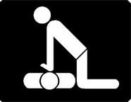
Unit 6 CPR, First Aid & AED
Vital Signs
Health Science Technology
2014

Slide 2
Rationale & Objectives
Health care workers are responsible for the accurate assessment of vital signs.
Upon completion of this lesson, the student will be able to:
Distinguish between normal, prehypertension & hypertension
Accurately measure adult blood pressure
Evaluate a peer using blood pressure check-off
Engage
Discovery Education Video Quiz & Application Packet

Slide 3
Blood Pressure Assessment
Page 111

Slide 4
Blood Pressure
The measurement of the force of the blood against artery walls:
Force comes from the pumping of the heart
If arteries are hardened or narrowed, this force might be increased to pump the blood throughout the body
Measurement is done by listening for two sounds with a stethoscope- the first sound and the change in sound/or in some instances the last sound.
Systolic- measures the pressure in an artery when the heart is contracting
Diastolic- measures the pressure in an artery when the heart relaxes between contractions
The units of measurement are millimeters of mercury:
The numbers are charted as systolic/diastolic
120/80 is an example of a blood pressure and this would be in millimeters of mercury, or “mm Hg”

Slide 5
Blood pressure values
Normal range of BP= 90-100/60 to 140/90
Hypotensive: someone whose BP is < 90-100/60.
May have symptoms of dizziness, light-headedness, fainting
No presence of signs and symptoms
Contributing factors include:
Medications
Level of physical fitness (ex. Someone who is extremely fit might be hypotensive, but this is normal for them)
Illness/injury
Hypertensive: someone whose BP is greater than 140/90.
“Silent Killer” (there are often no symptoms) but some experience headache, pressure in the head, ringing in ears, general feeling of malaise.
Continued elevation over time may cause Cerebral Vascular Accident (Stroke)
Contributing factors may include:
Overweight
Emotional upset
Family history
High salt diet
Pain
Illness
Medications

Slide 6
Possible underlying causes of Hypertension vs. Hypotension
Obesity
Family history
Smoking
Anxiety
Pain
*A hypertensive blood pressure of 180/110 is considered a MEDICAL EMERGENCY & needs immediate referral to a hospital.
Bleeding
Malnutrition
Medications
Dehydration
* A hypotensive blood pressure of less than 110/60 should be reported.
*Any change in blood pressure by 20-30 points should also be reported.

Slide 7
Aha recommendation
High blood pressure, or hypertension, is defined in an adult as a systolic pressure of 140 mmHg or higher and/or a diastolic pressure of 90 mmHg or higher.
Blood Pressure (mmHg) Normal Prehypertension Hypertension
Systolic (top number) <120 120-139 140+
Diastolic (bottom number) <80 80-89 90+
*mmHg= millimeters of mercury
High blood pressure directly increases the risk of coronary heart disease (which leads to heart attack) & stroke, especially with other risk factors.
Can occur in children or adults.
Prevalent in African Americans, middle-aged & elderly people, obese and heavy drinkers.
Those with diabetes mellitus, gout or kidney disease have hypertension more often.
Usually has no symptoms, truly a “silent killer”. But a simple, quick, painless test can detect it.
***Visit www.heart.org for more information.

Slide 8
Instruments necessary to complete the procedure
Blood pressure cuff (sphygmomanometer):
Must fit the arm properly & should be snug. *The width of the cuff should approximately equal the width of the upper arm.
For consistency the right arm should be used if possible.
The gauge should be calibrated and the needle should be on “0”.
Use dominant hand to pump (clockwise closes/counter opens).
Stethoscope:
Magnifies the sound heard.
Diaphragm (larger) /bell (smaller may be better for hearing sound).
Ear piece should face forward and down. *Always clean with an alcohol pad before and after use.

Slide 9
Procedure
Always wash hands & eliminate distractions (loud noises, etc.).
Person should be comfortably seated or lying down, legs uncrossed, arm resting with palm up.
Should have rested for 10-15 minutes prior to the reading. *If patient is a smoker, wait at least 30 minutes before taking a reading.
Arms that are paralyzed, injured, have an IV, recent blood test, breast removal (on that side) or shunt should not be used.
Infant BP can be taken on the leg; adults must use the arm.
Electronic blood pressure equipment can be used.
Excess air should be squeezed out of the cuff.
Cuff should be placed snugly on upper arm, directly on the skin.
Gauge should be easily visualized and set at “0”.
Valve should be closed, but easily able to be opened.

Slide 10
(continued)
Two techniques for obtaining the pressure:
Find radial pulse. Pump cuff until the pulse is no longer palpated, then pump another 30 mmHg higher. Place diaphragm of stethoscope on brachial artery about 1-1½ inches above the elbow. Release the valve and listen for the two measurements- slowly deflating the cuff.
Find brachial artery and put diaphragm over the site. Pump cuff to 120 mmHg and listen for the heart beat. If it is heard, pump another 30 mmHg and listen again. When the pulse is no longer heard, then pump another 30 mmHg and slowly deflate, listening for the two measurements.
If the reading is uncertain, you should wait 30 seconds to 1 minute before re-measuring.
Record the reading and report any abnormalities. If the BP reading is outside of the normal limits, retake it before reporting the value to a supervisor to be certain of accuracy.

Slide 11
Assignment: successful completion of Blood Pressure Skill Sheet
Materials:
Sphygmomanometer
Stethoscope
Alcohol swabs or cotton balls/alcohol
Assessment:
Blood Pressure Test
Reinforcement:
The student will list the steps and retake the blood pressure of a partner.
Enrichment:
The student will design a pamphlet and set up a blood pressure booth in a local store, offering blood pressure checks and pamphlets to any interested customers.

Slide 12
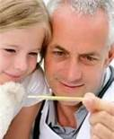
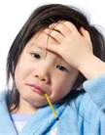
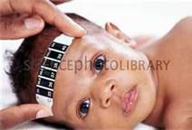
temperature
Page 113

Slide 13
Body Temperature
The measurement of the balance between the heat produced and lost by the body.
Methods & Normal readings:
Mouth (oral) 97.6-99.0°F
Armpit (axillary)- 96.6-98.0°F
Rectum (rectal)- 98.6-100.0°F
Ear (temporal)- 96.4-100.4°F
Temperature strips- used for young children on the forehead
Infrared radiation- 97.6-99.0°F (can be measured this way without touching the patient)

Slide 14
Pulse & Respiration
Page 114

Slide 15
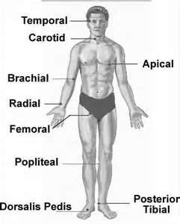
Pulse
The heartbeat that can be felt (palpated) on the surface arteries as the artery walls expand.
Usually counted using the radial artery near the wrist, but may be found in other locations *see picture
Pulse ranges by age group:
Newborn 70-170 bpm
Infant 80-130 bpm
School age 70-100 bpm
Adult 60-100 bpm
Abnormal pulse rates:
<60 bpm (bradycardia)
>100 bpm (tachycardia)

Slide 16
respiration
One respiration includes the inspiration (inhaling) and expiration (exhaling) of a breath.
The normal respiration rate is more rapid in infants than in adults (14-20/minute).
Abnormal parameters:
>24 (tachypnea)
<10 (bradypnea)
The rhythm and character of respiration are important observations to consider.
Rhythm describes regularity (ex. Regular)
Character describes depth and quality (ex. Effortless, deep, & quiet)

Slide 17
assignment
Practice assessing the following vital signs with a partner, & record values.
Blood pressure
Pulse
Respiration
Temperature

Slide 18
Emergency First-Aid
Page 122

Slide 19
First-Aid
Immediate care given to the victim of injury or sudden illness.
Purpose is to sustain life or prevent death.
Basic first aid training includes:
Prevention
Assessment
Treatment of illness and injury
*Triage- setting priorities for care of the victim or victims
Accredited certification agencies:
American Red Cross (ARC)
American Heart Association (AHA)

Slide 20
First-aid training topics of interest
Wounds
Poisoning
Burns
Shock
Fracture
Temperature alterations
Illness caused by medical conditions
Other injuries

Slide 21
wounds
Result when tissue is damaged externally or internally.
An example of an internal wound is a contusion or “bruise”.
Six types of external wounds in different bleeding situations:
Abrasion- results from scraping the skin or mucous membrane, minimal bleeding, infection possible.
Incision- a cut made with a surgical instrument, knife, or glass; “straight edge” wound, rapid and heavy bleeding.
Laceration- irregularly shaped cuts from random objects, of all wounds these usually bleed the most.
Puncture- when an object pierces the skin, limited bleeding but a high risk of infection.
Avulsion- traumatic tearing away of part of the body, bleeding rapid and heavy; body part may be reattached or reinserted depending.
Amputation – surgical severing or cutting away of part of the body.

Slide 23
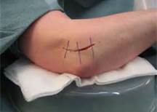
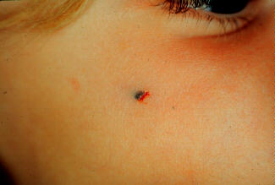
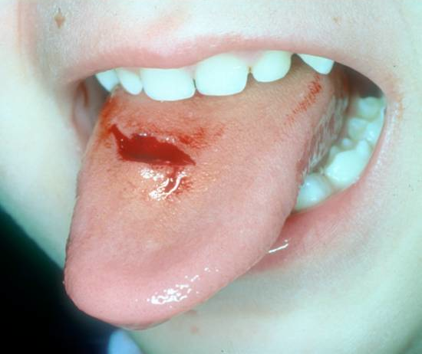
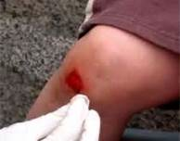

Slide 24
Bleeding from wounds
Occurs from all three types of blood vessels.
Arterial blood- bright red, pulses as the heart beats, the most serious type to be concerned with.
Venous blood- darker in color, doesn’t pulse.
Capillary blood- oozes at the surface of the skin.
*Shock & loss of consciousness can result from loss of blood in a short amount of time.
So what can you do?
Apply direct pressure, & to pressure point if possible
Don’t remove the dressing
Elevate the injured area
Apply tourniquet above level of wound only as last resort
Cool any avulsed tissue or parts *NOT DIRECTLY ON ICE

Slide 25
burns
Result from exposure to heat, chemicals, or radiation.
Severity is determined by location, depth, and size.
Types of burns:
First degree- affect only the outer layer of skin, red & discolored, possibly slight swelling, healing is rapid (ex. sunburn, or briefly submerging body part in hot water)
Second degree- breaks skins surface and injures underlying tissue, appearance of blisters, skin is red or mottled, may be wet from plasma loss through skin, causes greater pain and swelling (ex. Severe sunburn, exposure to hot liquids or heat)
Third degree- deep enough to damage nerves & bone, tissue is charred and white, may cause less pain because of nerve damage (ex. may result from exposure to fire, hot water, hot objects or electricity)

Slide 26
Treatment of burns
First-degree
Immerse area in cool water
Apply dressing to the area
Second-degree *seek medical attention if affected area is large
Immerse area in cool water
Do not open blisters or apply ointments
Elevate affected area
Third-degree *seek medical attention
Don’t remove clothing adhering to burn
Cover burn with clean, dry dressing
Elevate if possible
Don’t apply ointments, water, or butter

Slide 27
Poisoning
Most occurs in the home.
Poisoning exposure:
Ingested
Inhaled
Absorbed
Injected
Obtained by radiation
Signs & Symptoms:
Discoloration or burns on the lips
Unusual odor
Vomiting (emesis)
Presence of a suspicious container

Slide 28
shock
The response of the cardiovascular system to the presence of adrenaline, resulting in capillary constriction.
May result from the following:
Trauma
Electrical injury
Insulin shock
Hemorrhage
Reaction to drugs
In conjunction with other injuries/illnesses (respiratory distress, fever, heart attack, poisoning)
*Anaphylactic shock- response of the body to an allergen such as a medication

Slide 29
Signs and symptoms of shock
Early S/S:
Pale and clammy skin
Weakness
Restlessness
Pulse/respiration rate is rapid
Vomiting possible
Late S/S:
Apathy
Unresponsiveness
Dilated pupils
Mottled skin
Loss of consciousness
*May result in death if the condition is not reversed.

Slide 30
fractures
A break of a bone.
Classified as either “closed” or “open”.
Simple, or closed, fractures do not penetrate the skin.
Treatment: splint in the position found.
Immobilization reduces pain and risk of injury.
Open, or compound, fractures happen when the bone breaks through the skin and is exposed.
Seek medical attention asap
Stop bleeding, immobilize to reduce pain & prevent further injury (any movement may damage tissues)
Open fractures present a greater chance of infection.

Slide 33
Kevin Ware http://www.youtube.com/watch?v=6PSV0AV1BI0

Slide 34
Temperature alteration
As we have learned, the human body works well at a specific temperature. If there is too much variation of the normal temperature, the body cannot function.
Types of temperature alteration:
Heat cramps
Heat exhaustion
Heat stroke
Hypothermia
Frostbite

