Slide 1
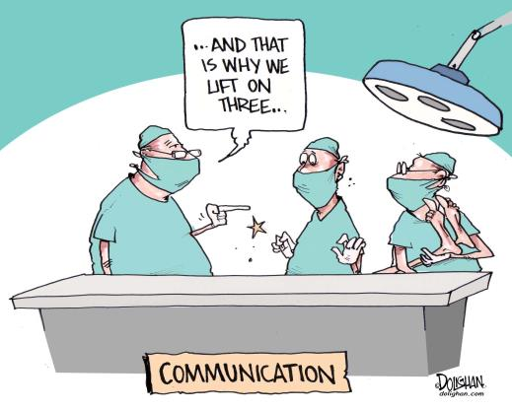
Verbal Communication Unit 2 Communication
Health Science
Ms. Thieman
2013-2014

Slide 2
Rationale Expertise in communication skills is necessary for workers in health care. To deliver quality health care, the health care provider must be an effective communicator.
Objectives
Upon completion of this lesson, the student will be able to: • Develop verbal communication skills • Adapt communication to the needs of the individual • Distinguish between therapeutic and non- therapeutic communication

Slide 3
Engage
Watch the following video:
CDC Saving Lives, Protecting People
www.cdc.gov/CDCTV/TwentyFourSeven
How does the CDC communicate with the public?
What do you feel is the most important aspect of the CDC?

Slide 4
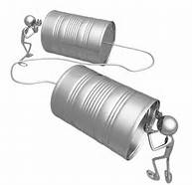
Verbal Communication
Exchange of information using words
Includes both the spoken and written word
Uses of Verbal Communication
Interactions with patients, families and co-workers
Giving reports to other health care professionals
Documenting patient care

Slide 5
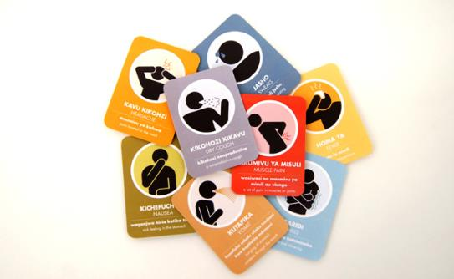
Elements of effective communication
The message must be clear
Conversation (exchange of verbal communication) skills
Therapeutic Communication Skills
Non-Therapeutic Communication Skills

Slide 6
The message must be clear
Use terms that the receiver can understand
Know the developmental level of the patient you are caring for and use language appropriate to that level, ( e.g. you might be able to ask an adult to urinate in order to collect a urine specimen, but a child might not understand what you mean by ‘urinate,’ and another term might have to be used.)
Deliver the message in a clear and concise manner
Good grammar and correct pronunciation are essential
Avoid slang terms, words with double meanings, or meaningless phrases such as “you know”, or “all that stuff”
the tone and pitch of voice are important
Do not speak too fast or too slowly
In written communication, the message should be spelled correctly, contain correct grammar, proper punctuation, and it should be concise

Slide 7
Continued…
The receiver must be able to hear and receive the message
Patients may be heavily medicated, have a hearing or vision loss, or speak a different language
Use alternate ways to communicate such as writing the message out, using an interpreter, or repeating the message
The receiver must be able to understand the message
Use terms the patient understands
The patient’s attitudes and prejudices may interfere with understanding (e.g. if they don’t have confidence in the health care worker, they may not accept the message)
the health care worker’s attitudes and prejudices may interfere with understanding, ( e.g. if the health care worker feels that the patient is uncooperative, they may not respond correctly to the patient)
Interruptions or distractions must be avoided
Trying to talk while answering the phone or writing a message will decrease the effectiveness of communication
Environmental factors may affect communication, (e.g. uncomfortable temperatures or loud noises such as a loud TV or radio may interfere with communication)

Slide 8
Conversation (exchange of verbal communication) skills
Control the tone of your voice: convey interest instead of boredom, patience rather than anger
Be knowledgeable about the topic of conversation: be honest and confident
Be flexible: you may want to discuss a certain subject and the patient wants to discuss something else
Be clear and concise: stay on one subject at a time
Avoid words that might have different interpretations
Be truthful
Keep an open mind: patients and other health care workers have valuable contributions
Take advantage of available opportunities

Slide 9
ORGANIZATIONAL COMMUNICATION
http://www.youtube.com/watch?v=e5oXygLGMuY#t=176

Slide 10
Therapeutic Communication Skills
Listening
sit when communicating with the patient
be alert and relaxed and take sufficient time
maintain eye contact
indicate that you are paying attention to what the patient is saying
Silence
take the time to wait for the patient to initiate or to continue speaking
allow the patient and health care worker time to reflect on what has been said and to collect thoughts
Offering Self: Can I help in some way?
shows caring and concern
shows readiness to help
Reflection: repeating what the patient has said
validation that this is what was meant
encourages further verbalization
Encouraging Elaboration: Tell me how that felt.
used to elicit information about a subject
helps the patient clarify unclear thoughts or ideas
General Leading Statements: Go on. I see.
used to get interaction started
encourages patient to continue or elaborate
Giving Information: The test results take 48 hours to return to us.
Informs the patient of specific information relevant to their health care
Requires feedback to make sure the patient receives the correct information
Open Ended Questions: “Tell me about your day,” rather than, “How was your day?”
Encourages elaboration rather than a 1 or 2 word answer
Creates an inviting atmosphere for sharing thoughts, and feelings

Slide 11
Non-Therapeutic Communication Skills
Don’t use clichés: Everything will be O.K. You don’t need to worry about that.
offers false reassurance
can be interpreted as there is no cause for concern
Don’t use questions beginning with why or how
requesting an explanation
puts patient or co-worker on the defensive
Don’t give advice
denies the patient the right to make their own decisions
increases patient’s dependence on health care providers
Don’t keep changing the subject
may keep the patient from talking about what is a concern to him/her
indicates that the health care worker is ignoring the patient
Don’t use judgmental comments: You aren’t acting very grown up, How do you think they would feel if they saw you like this?
imposes the health care worker’s feelings on the patient
belittles what the patient is feeling

Slide 12
THERAPEUTIC COMMUNICATION
http://wn.com/therapeutic_communication

Slide 13
Gender Bias
Words used often reflect a gender role bias: All nurses are female.
Gender roles have changed in the past ten years
To eliminate bias, avoid referring to doctors as male and nurses as female -- instead address the person by their name or title

Slide 14
Any Questions???
Activity
Complete Therapeutic and Non-therapeutic Activity.
Accommodations for Learning Differences
For reinforcement, students will identify terms and phrases used by family members which may be misunderstood by a health care provider.
For enrichment, students will interview someone from a different culture to determine complications encountered in a health care setting as a result of poor communication.

